Slide 1
DISEMINATION
ERASMUS PROJECT: Short-term exchanges of groups of Pupils
2020-1-PT01-KA229-078448
PRIMARY MUNICIPAL SCHOOL DITURIA
SARAJ/NORTH MACEDONIA
30/11/2023

Slide 2
a space for connecting EMJMD, EMJM and EMDM project team members | a space for supporting peer-to-peer learning and sharing best practices | a digital platform for engagement allowing people to collaborate across the Erasmus Mundus landscape | a subsection of the umbrella “Erasmus Networks Platform” | managed by NTT DATA for the EMSI under a service contract with the Education and Culture Executive Agency
Notes:
an open-source platform provided by the European Commission.

Slide 3
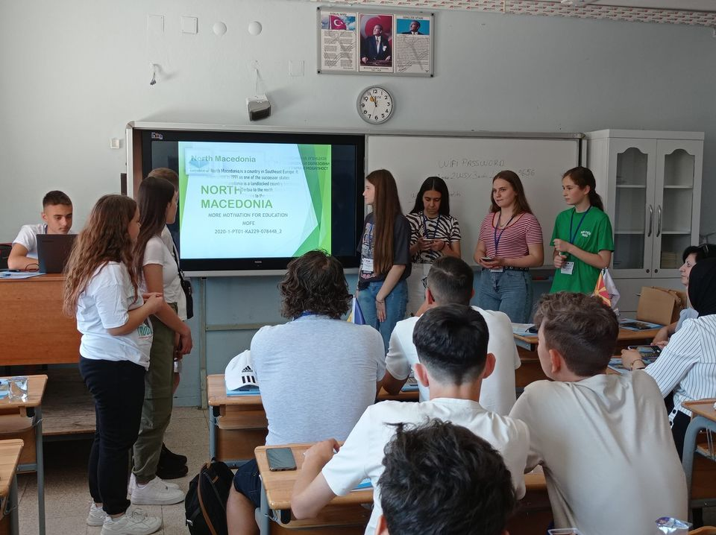
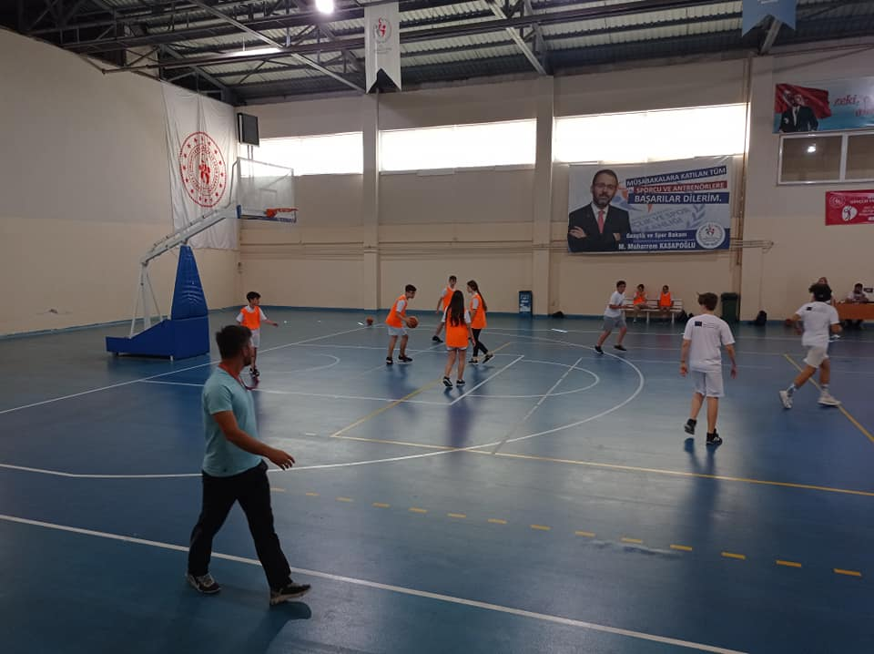
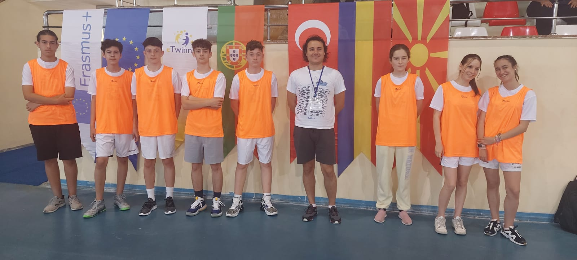
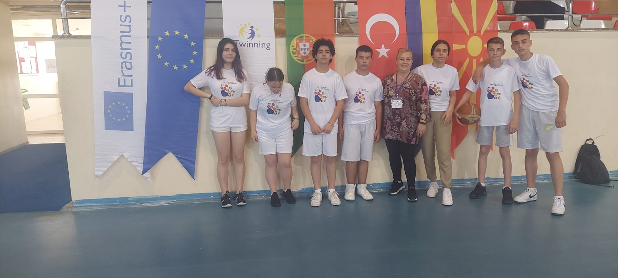
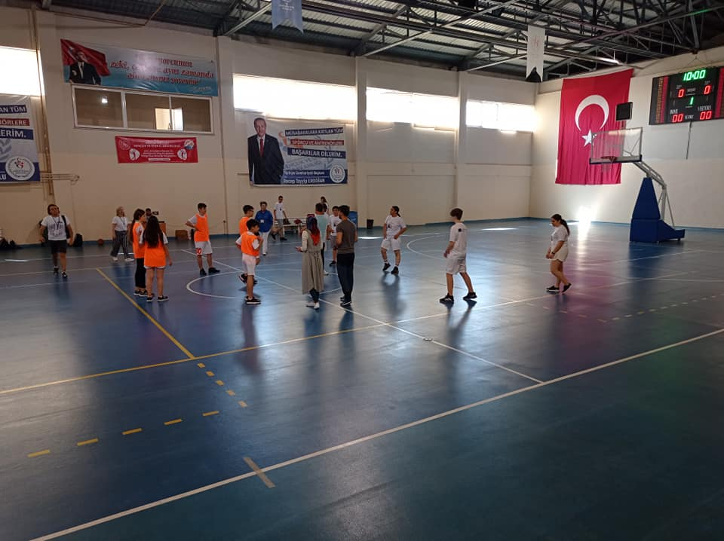
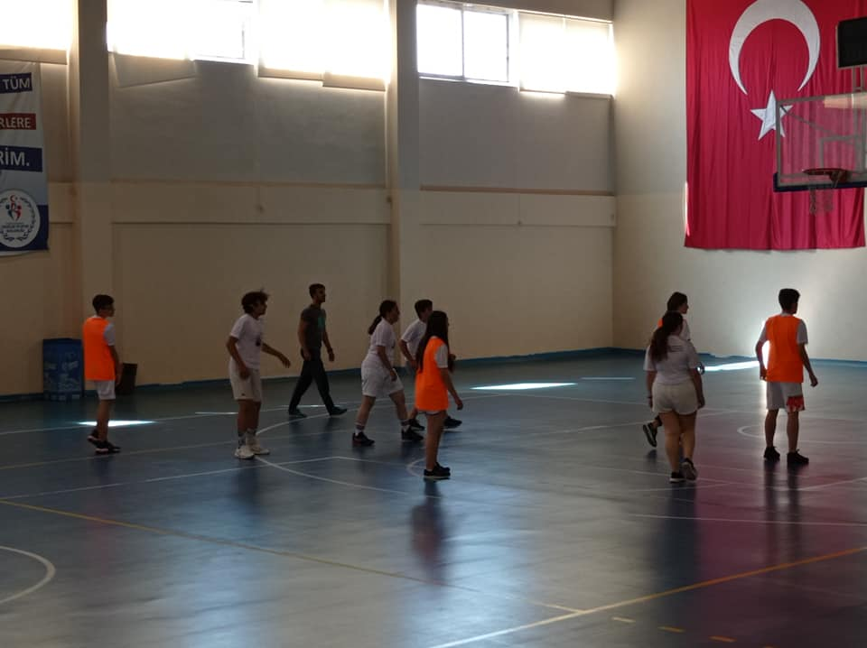
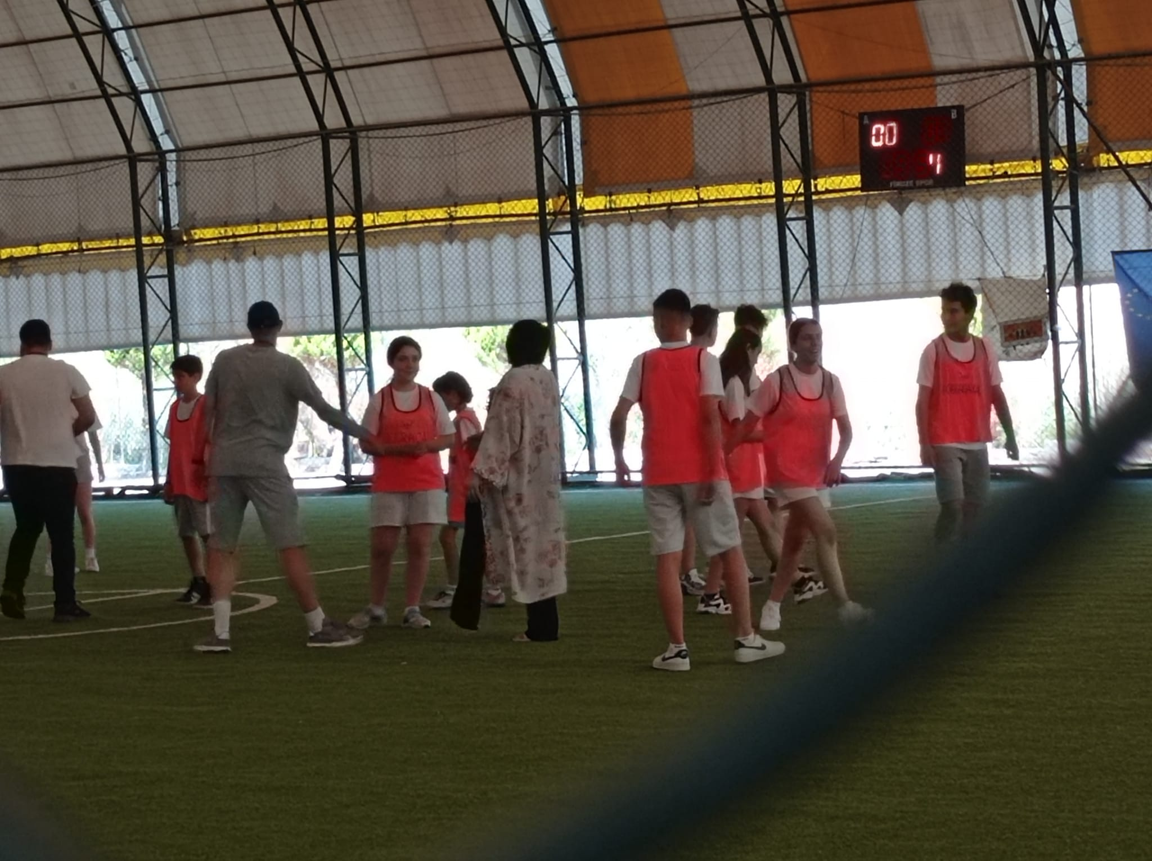
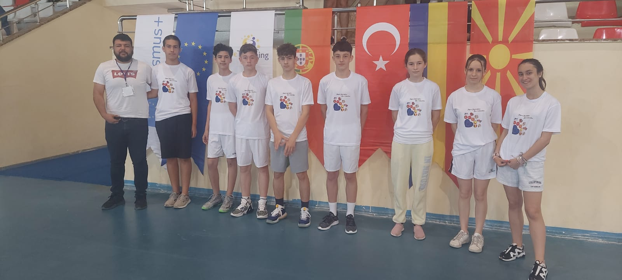
FIRST MOBILITY SPORT– ANAMUR, MERSIN, TURKEY
23 – 27.05.2022
TEACHERS | STUDENTS
Izeta Babachikj Lejla Abazi Firdez Fejzula Nusran Megdi Zejnep Zumeri | Furkan Emini Ena Sadrikj Merjem Zekjovikj Meljita Bisljimi Fitim Memishi Semra Sulejmani Bjondina Terzikji Ejesa Zuberi

Slide 4
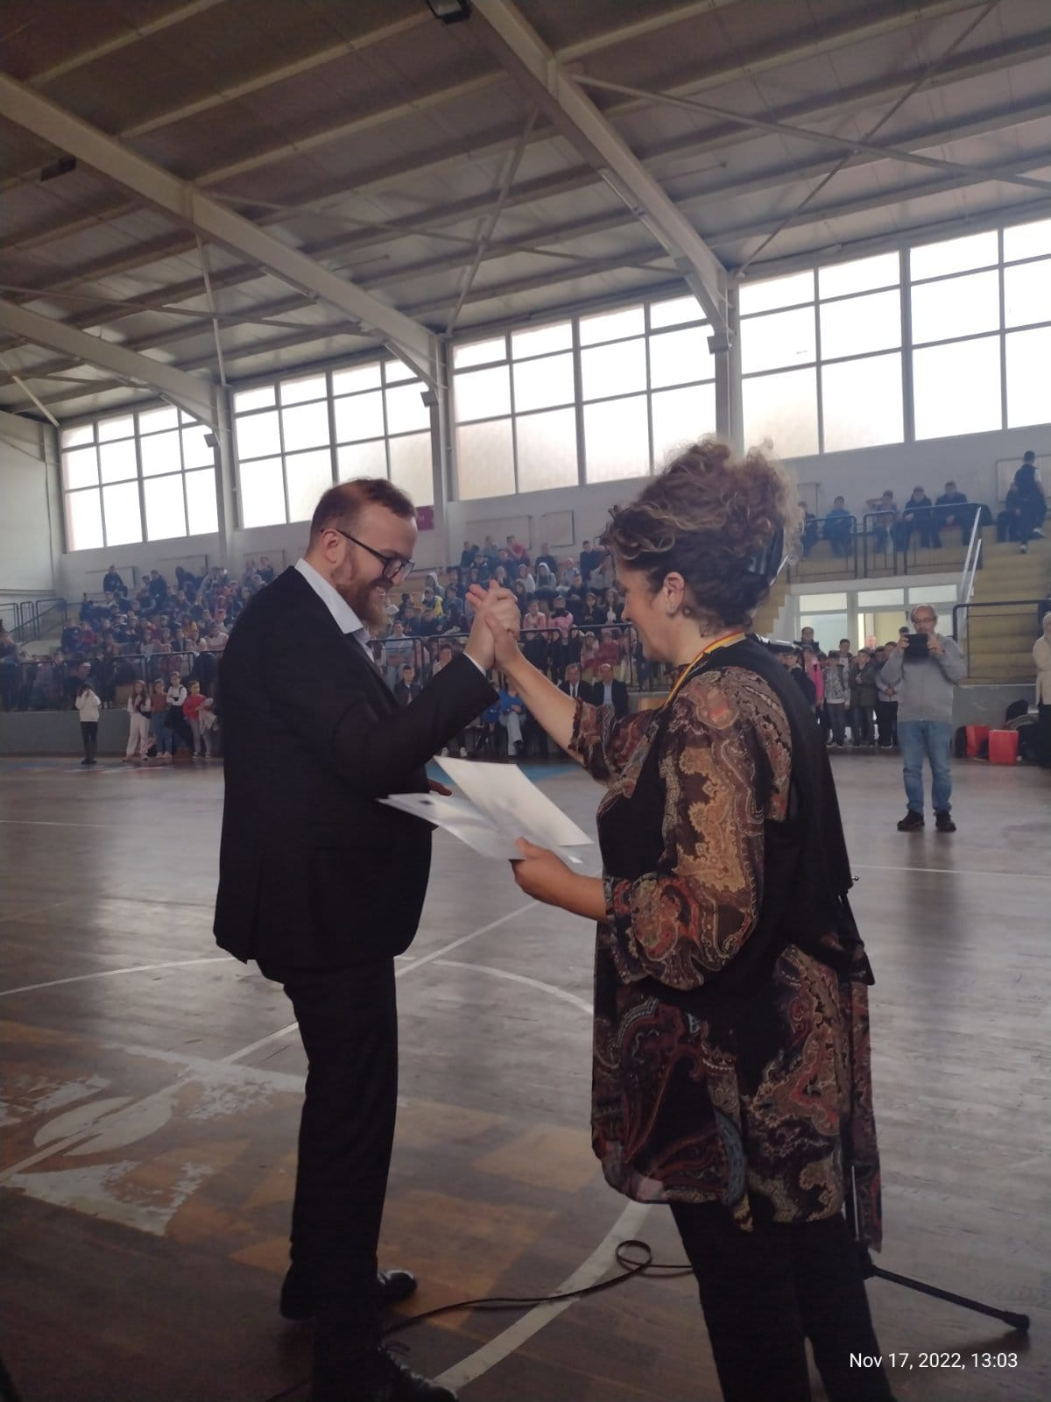
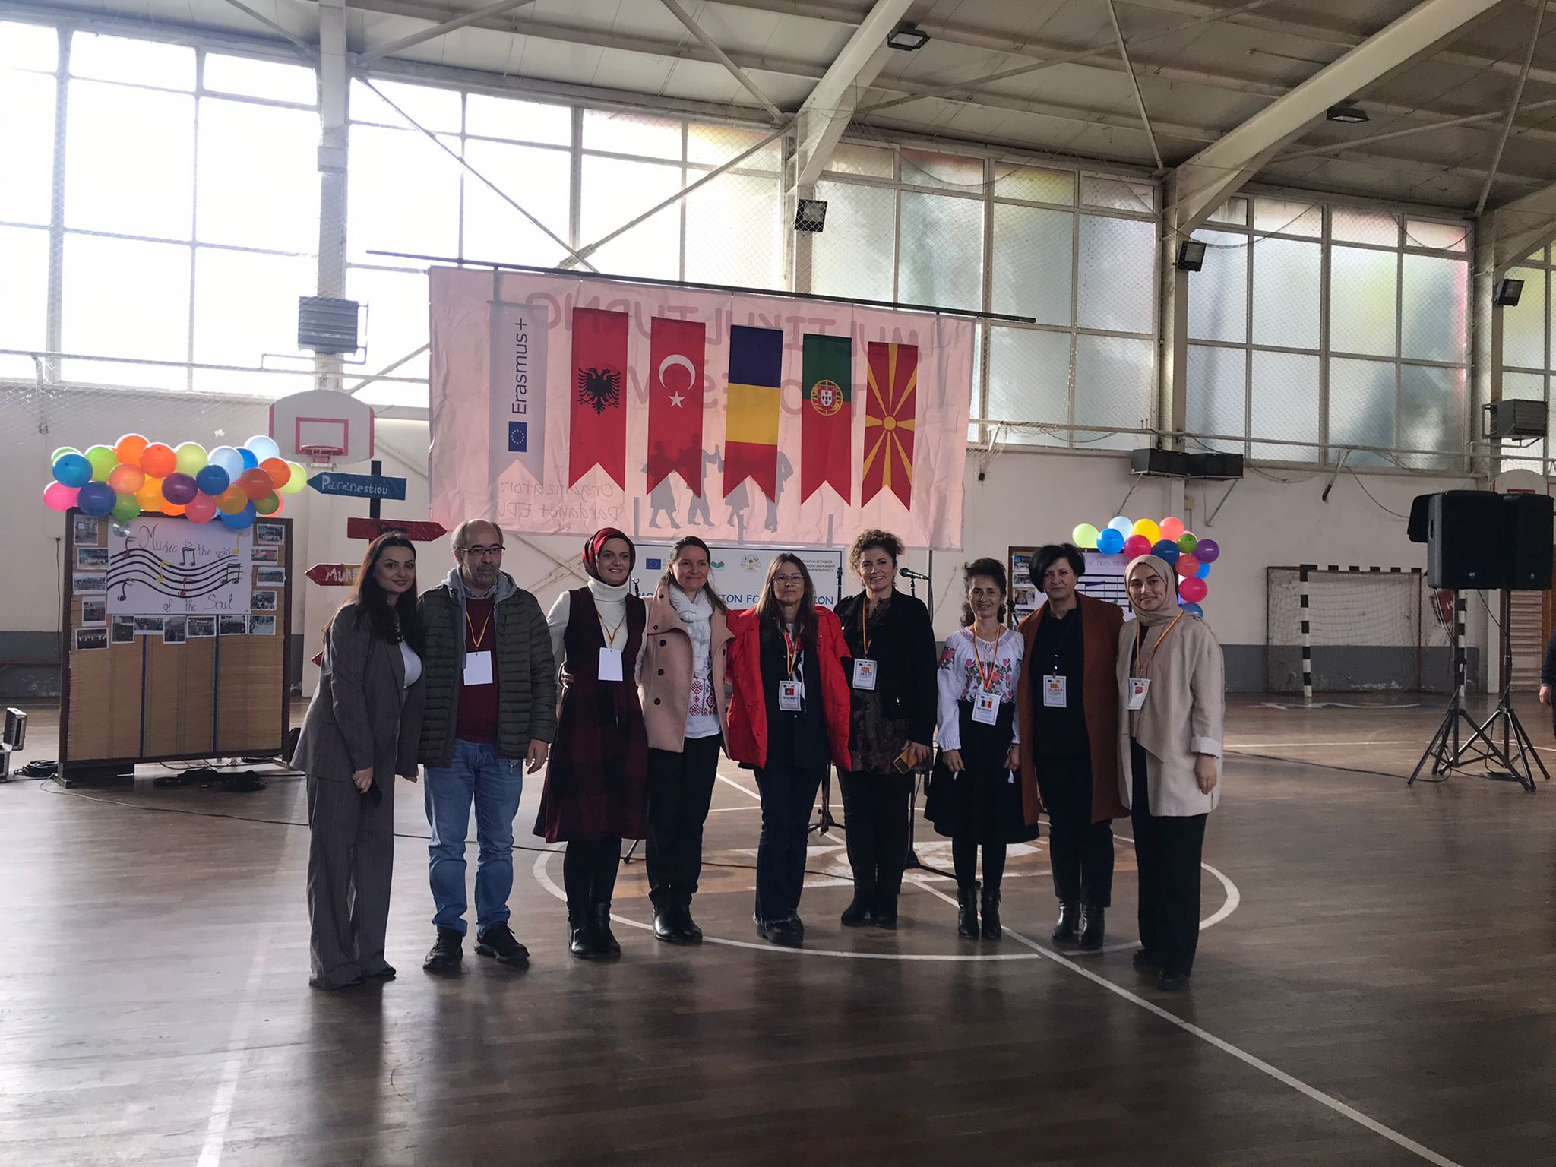
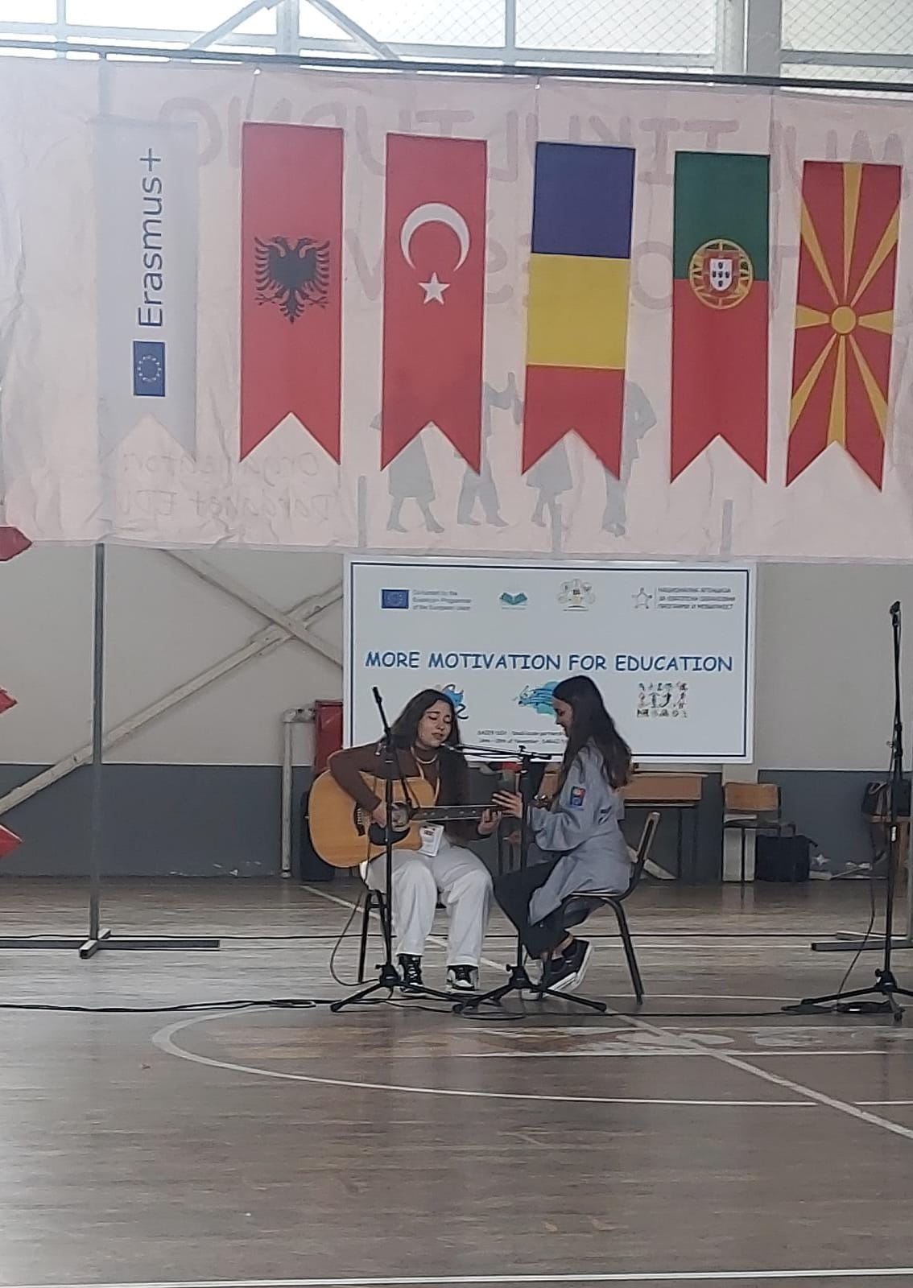
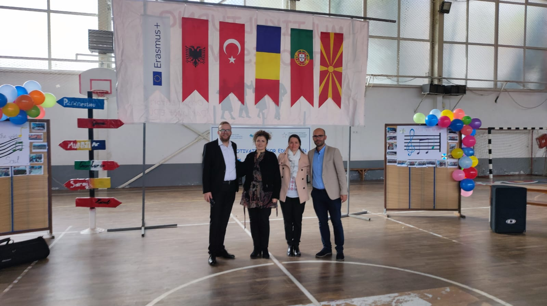
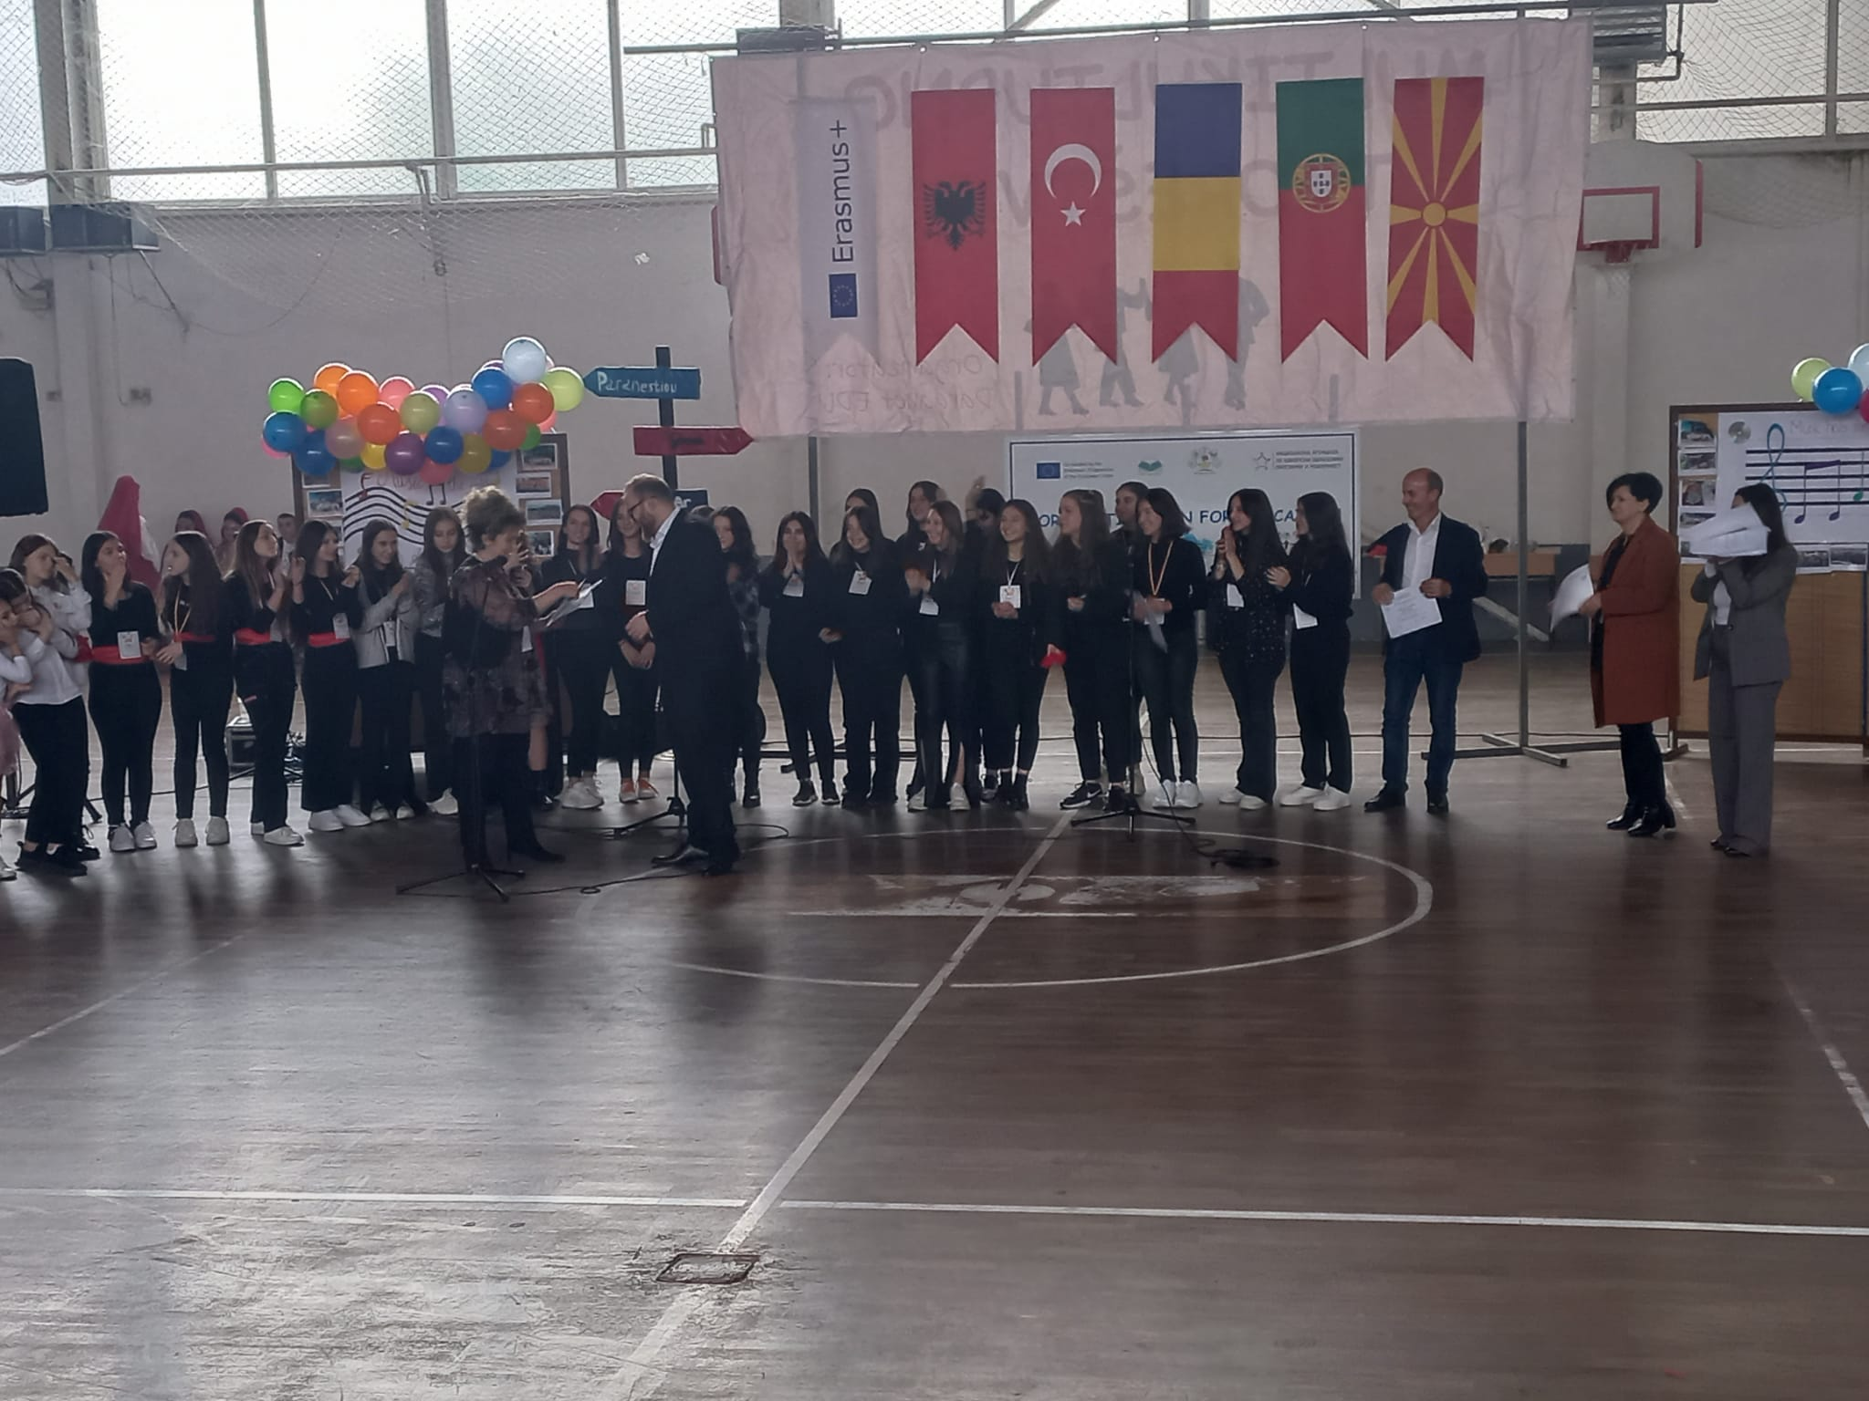
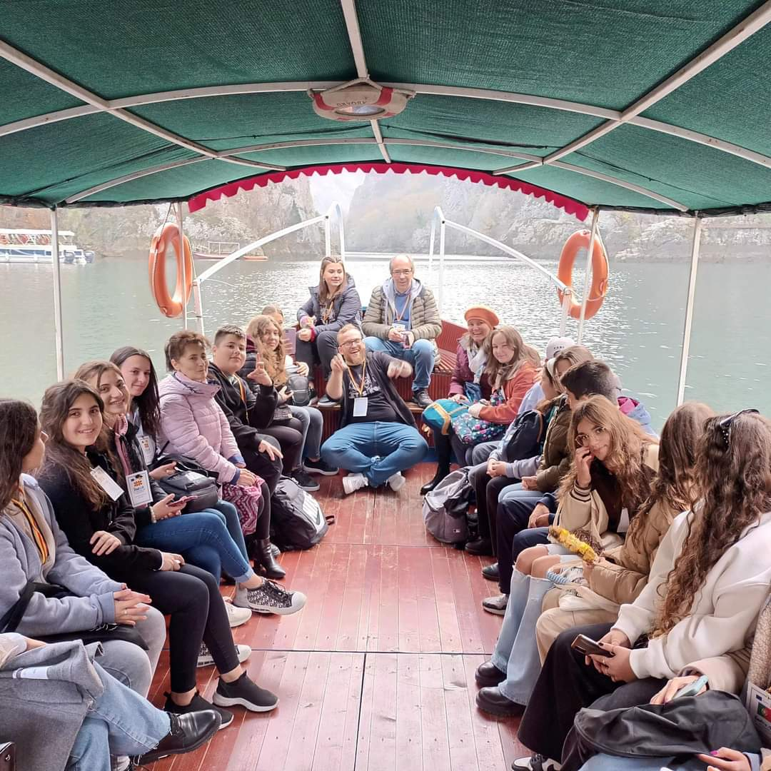
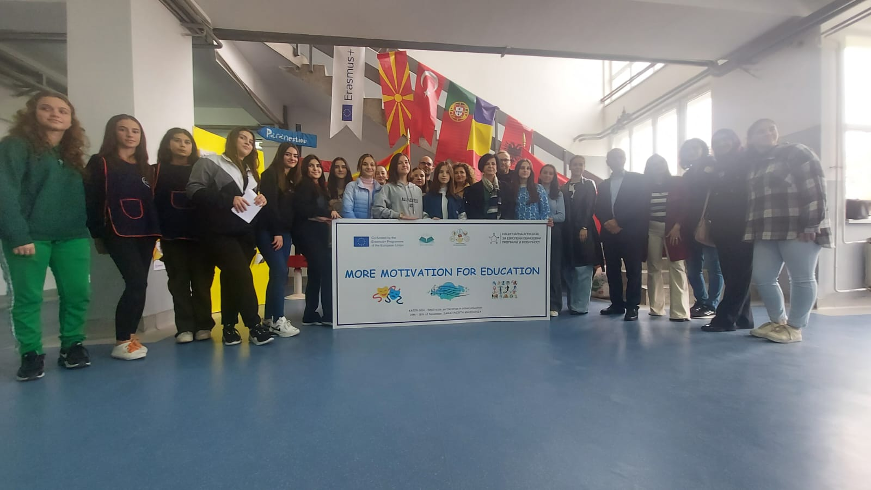
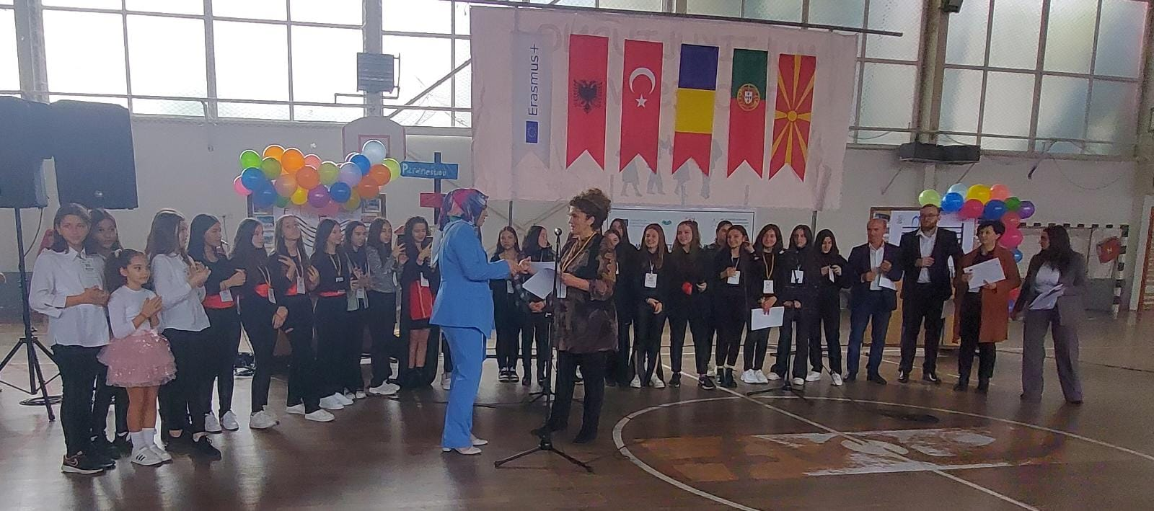
SECOND MOBILITY MUSIC – DITURIA, SARAJ, NORTH MACEDONIA
14 – 18.11.2022
TEACHERS | STUDENTS
Izeta Babachikj Lejla Abazi Firdez Fejzula Artan Mustafa Zejnep Zumeri Ibraim Nedjipi | Furkan Emini Ena Sadrikj Merjem Zekjovikj Meljita Bisljimi Fitim Memishi Semra Sulejmani Bjondina Terzikji Ejesa Zuberi

Slide 5
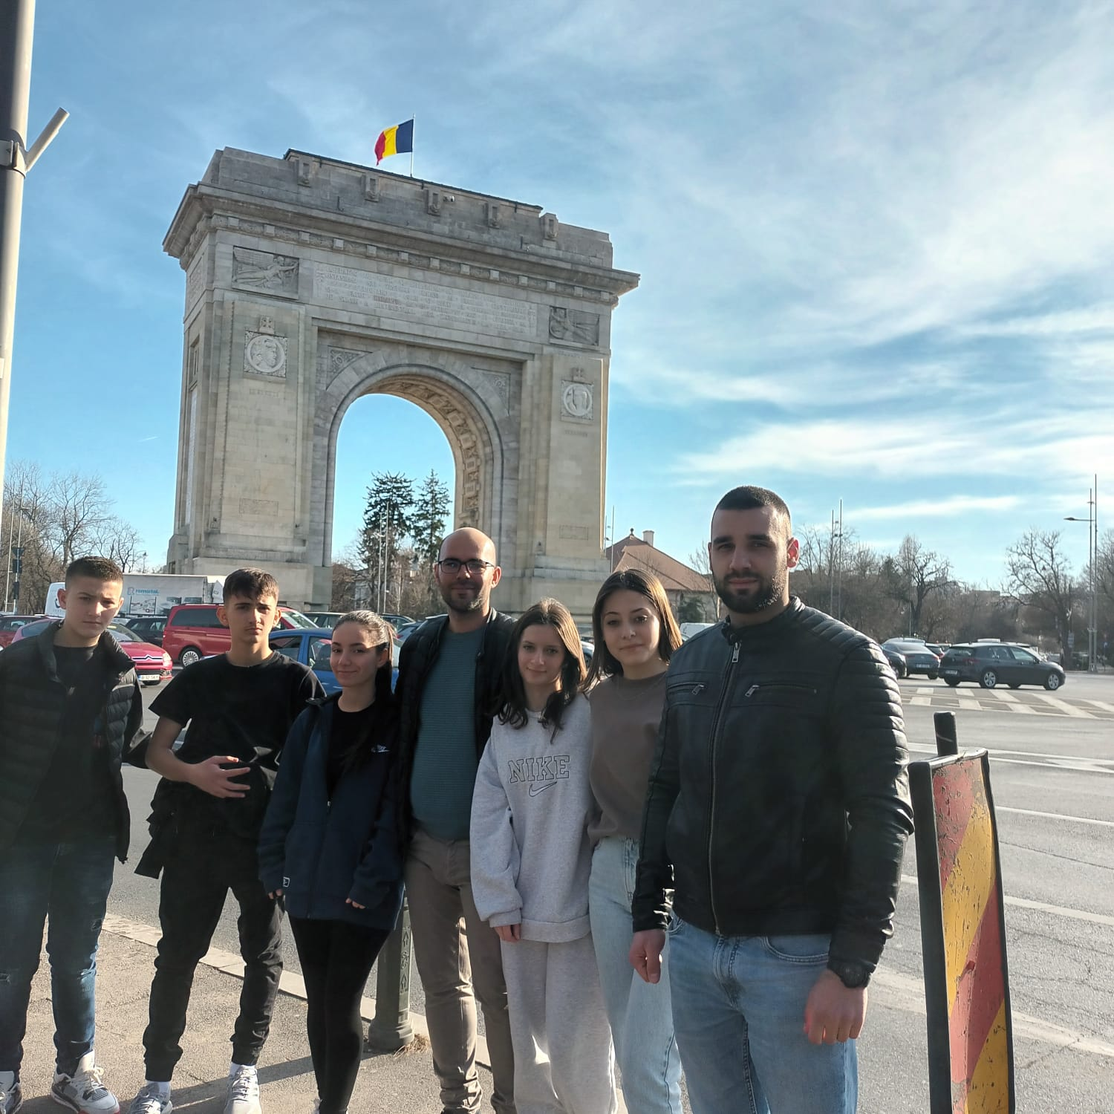
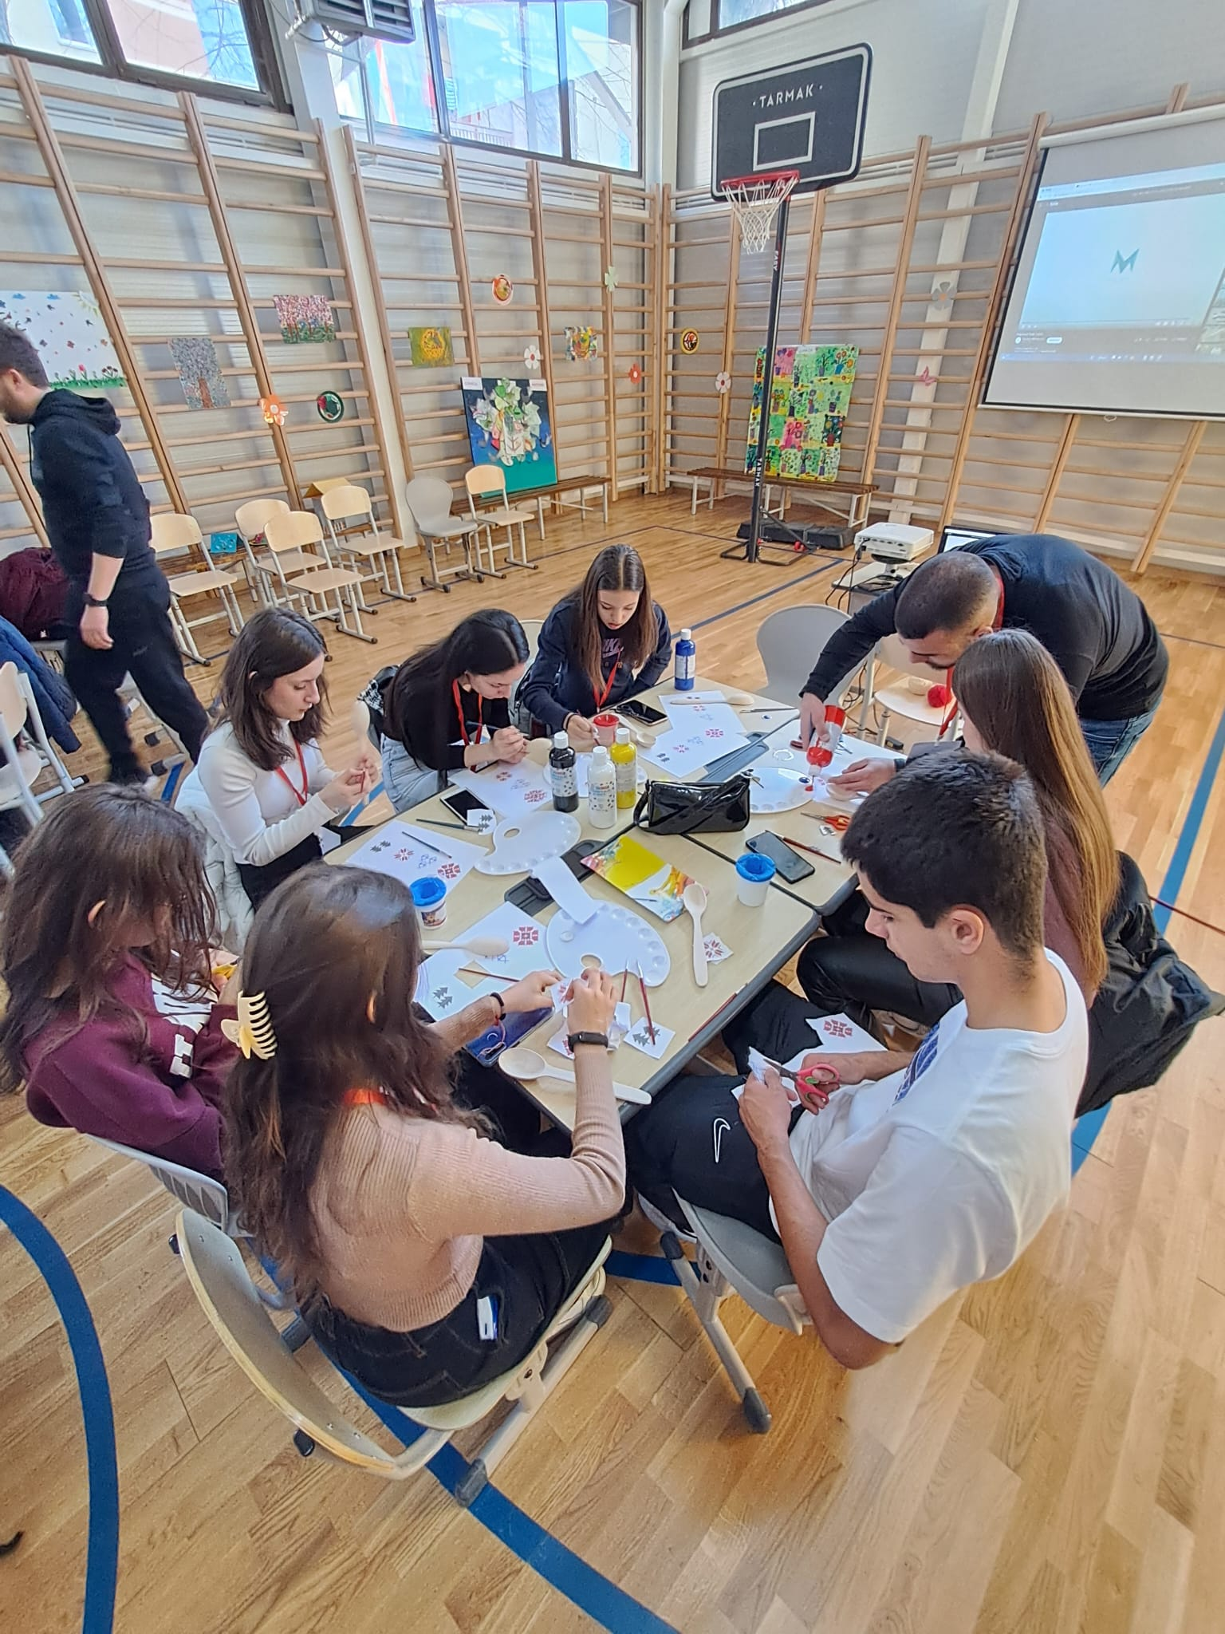
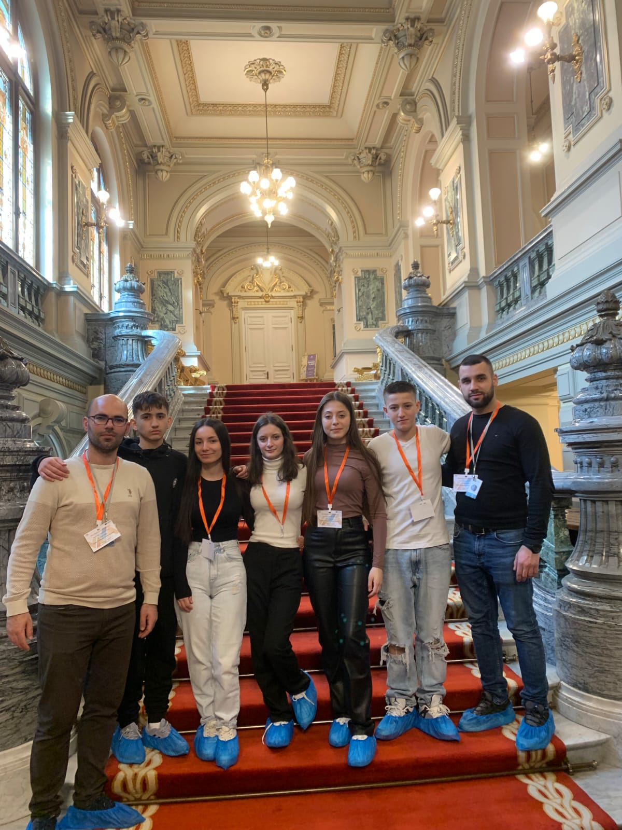
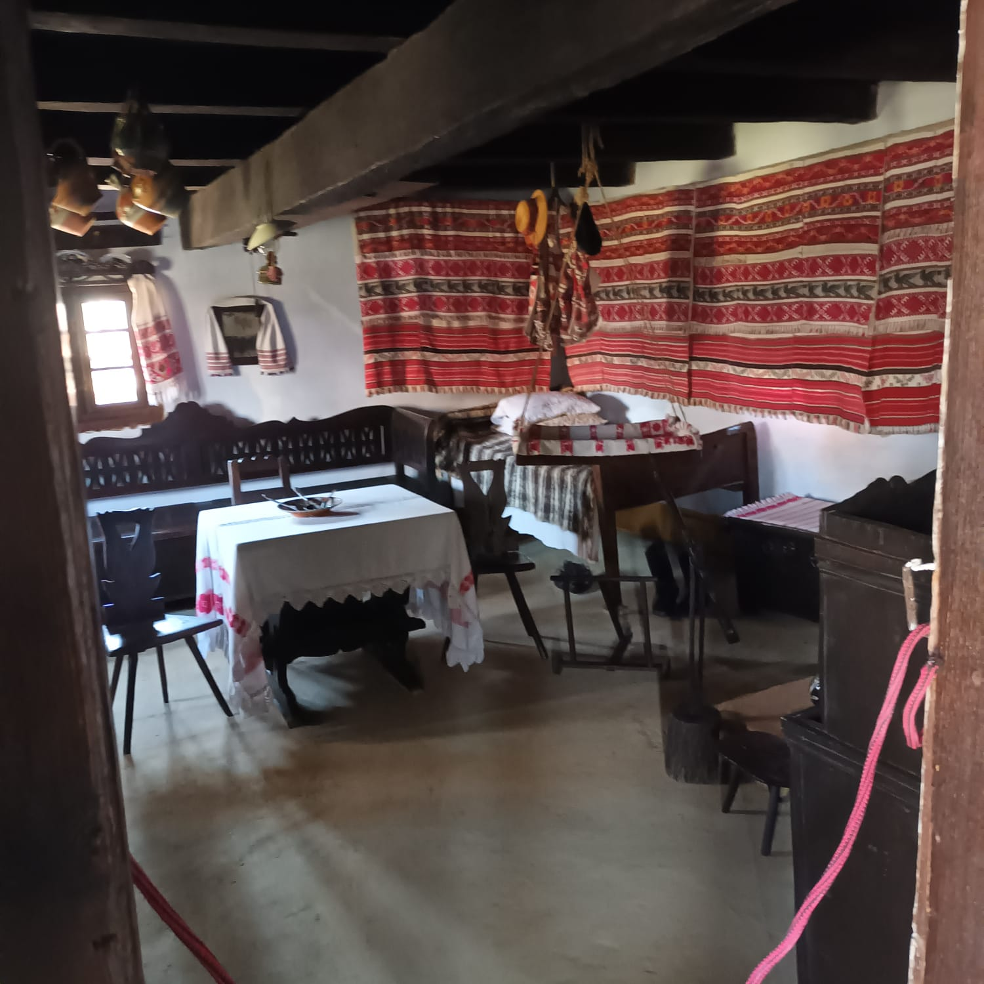
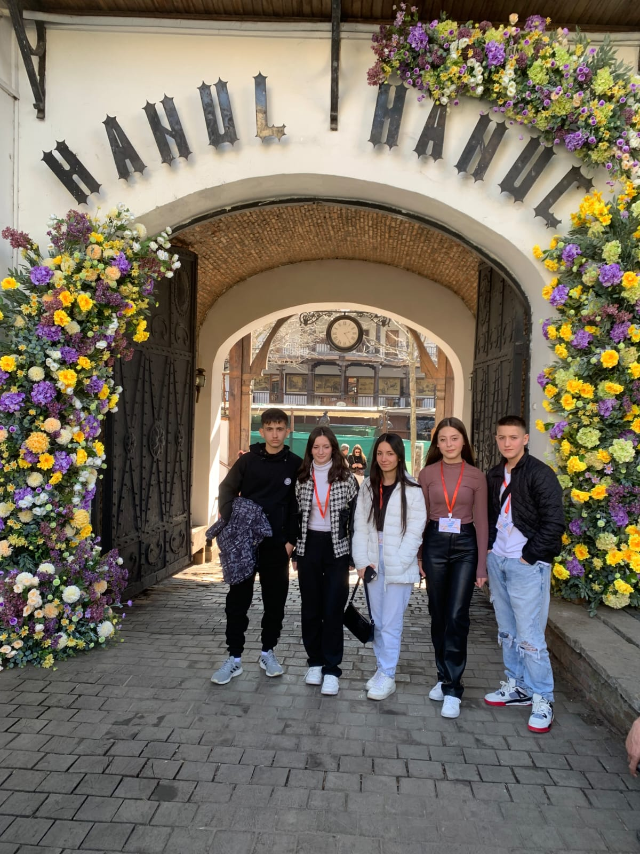
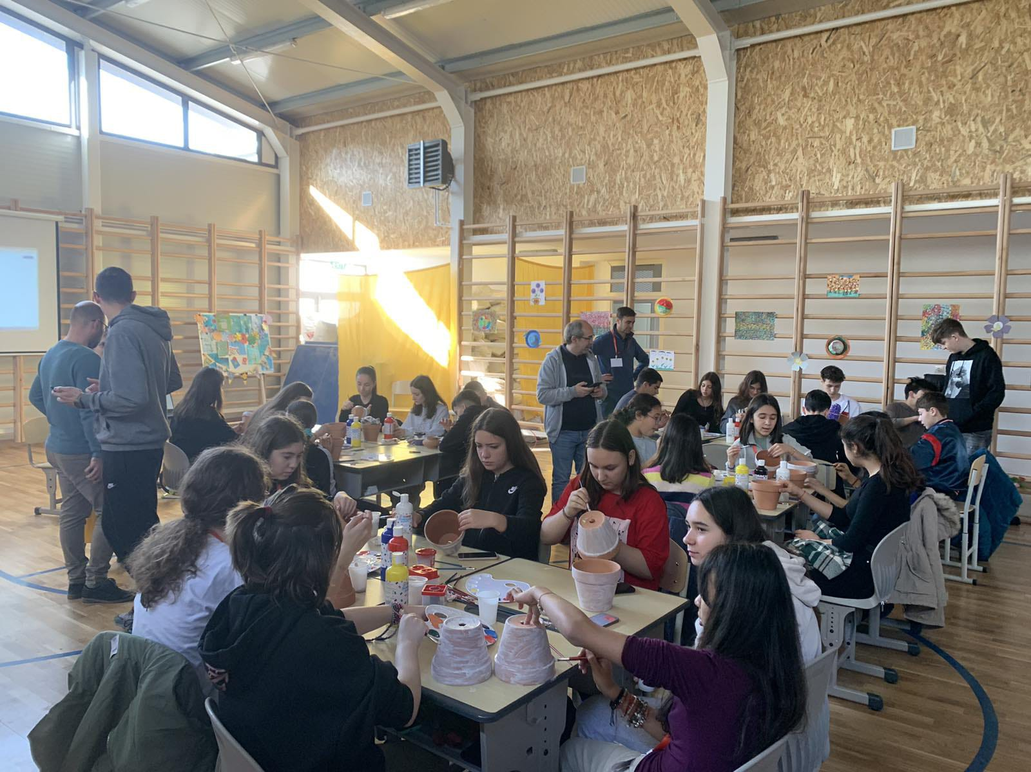
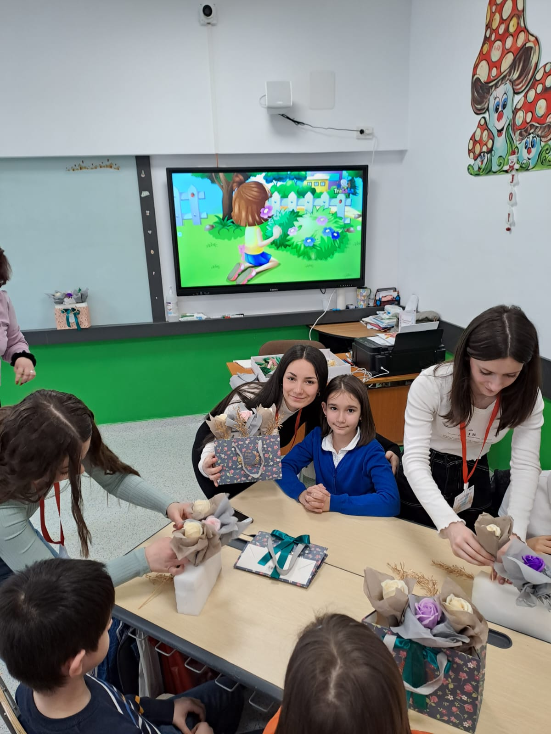
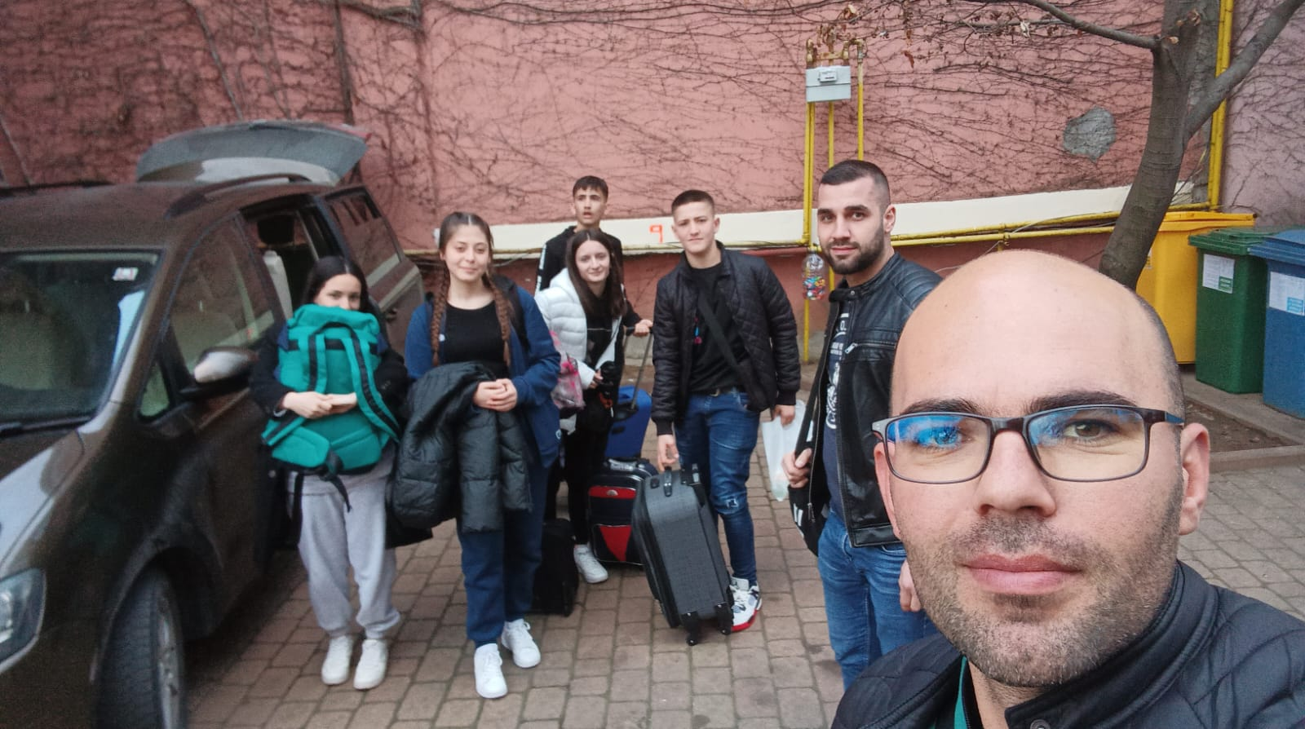
THIRD MOBILITY ART– BUCHUREST, ROMANIA
06 – 09.06.2023
TEACHERS | STUDENTS
Ibraim Nedjipi Mursel Ademi | Blin Belluli Davud Terzikji Anesa Bekteshi Kanita Ibraimi Sahra Ljoki

Slide 6
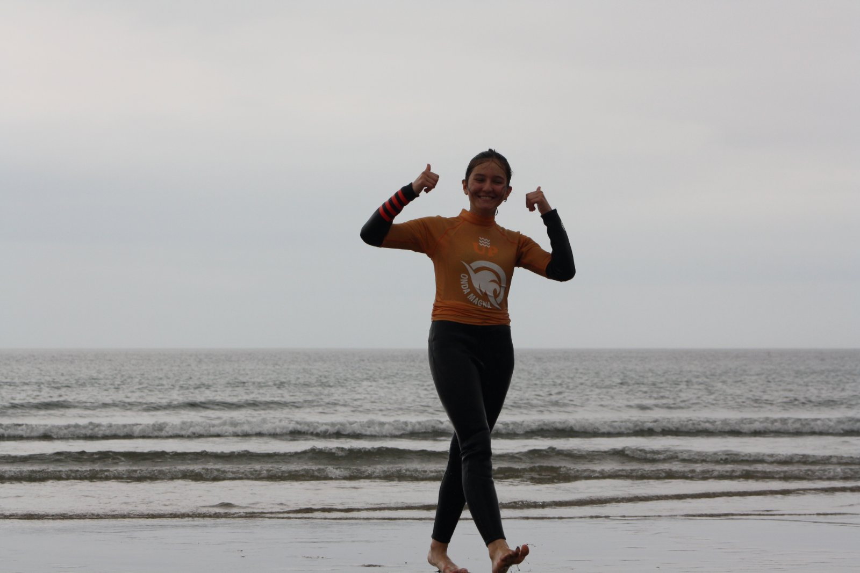
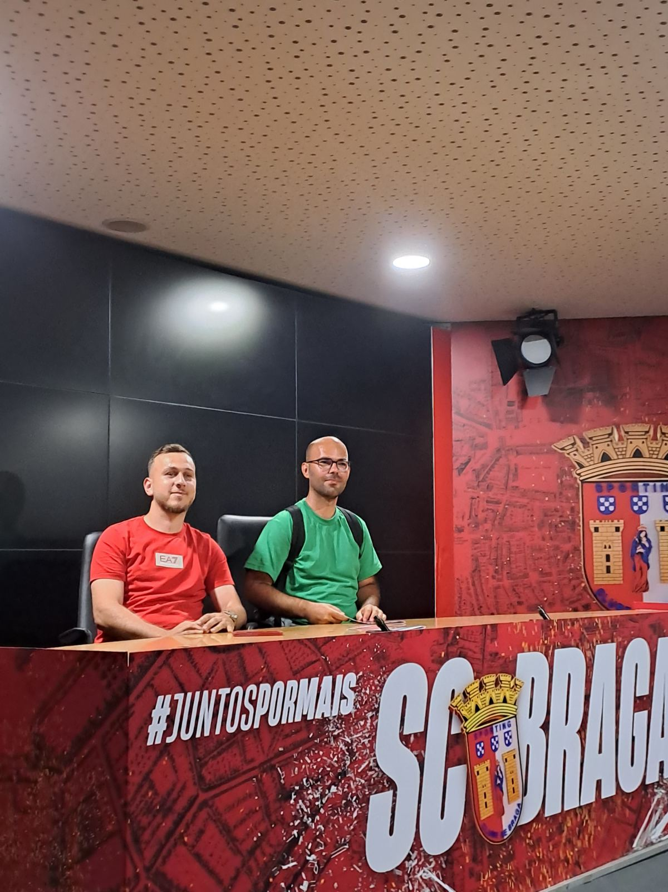
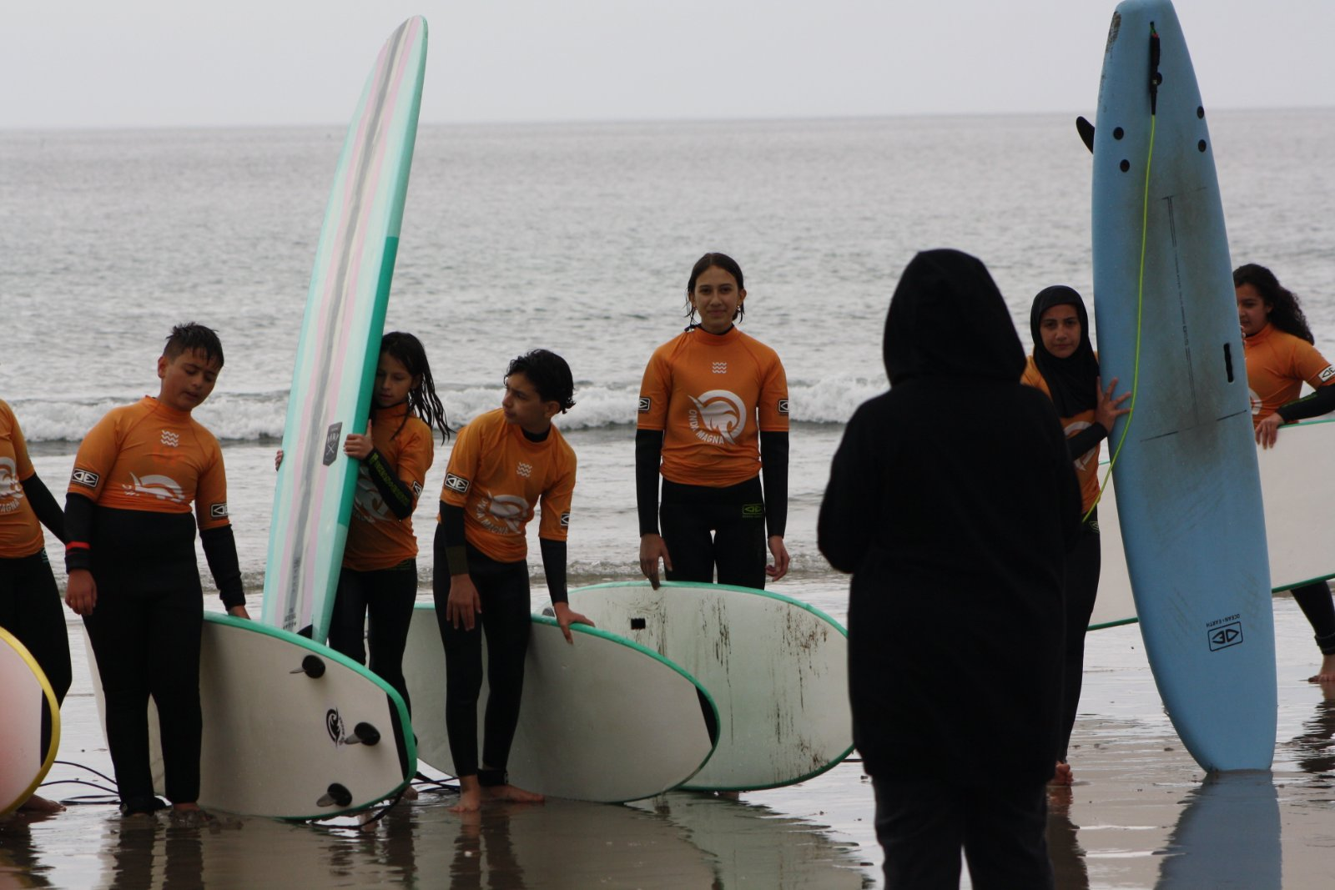
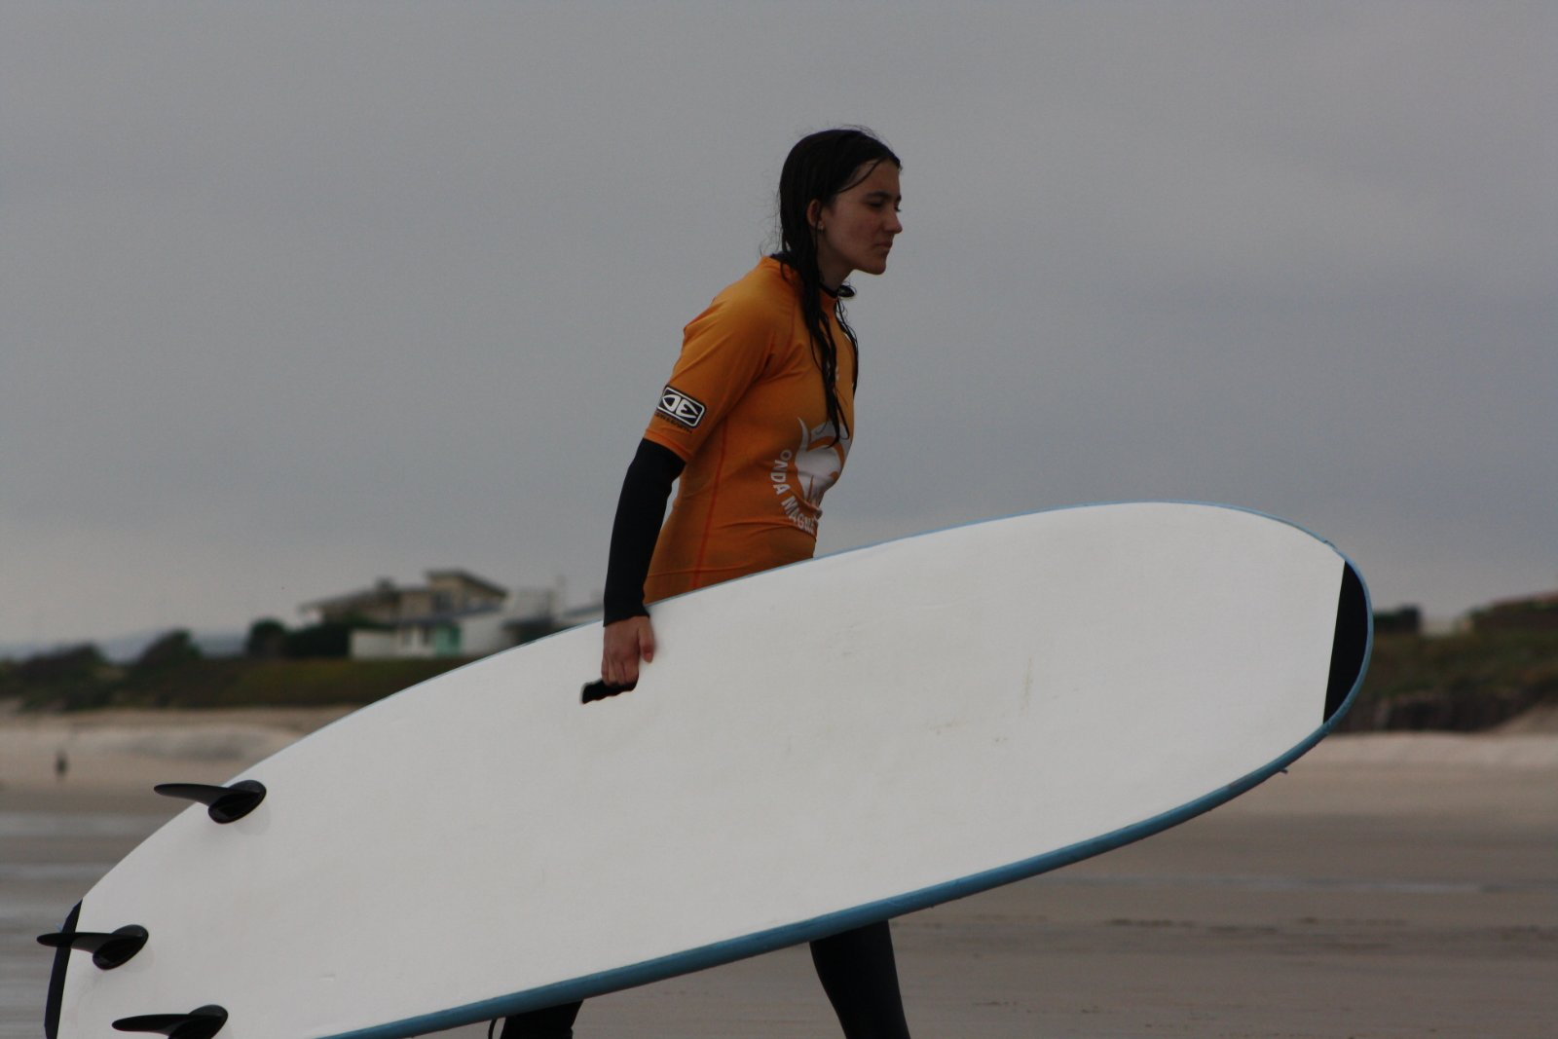
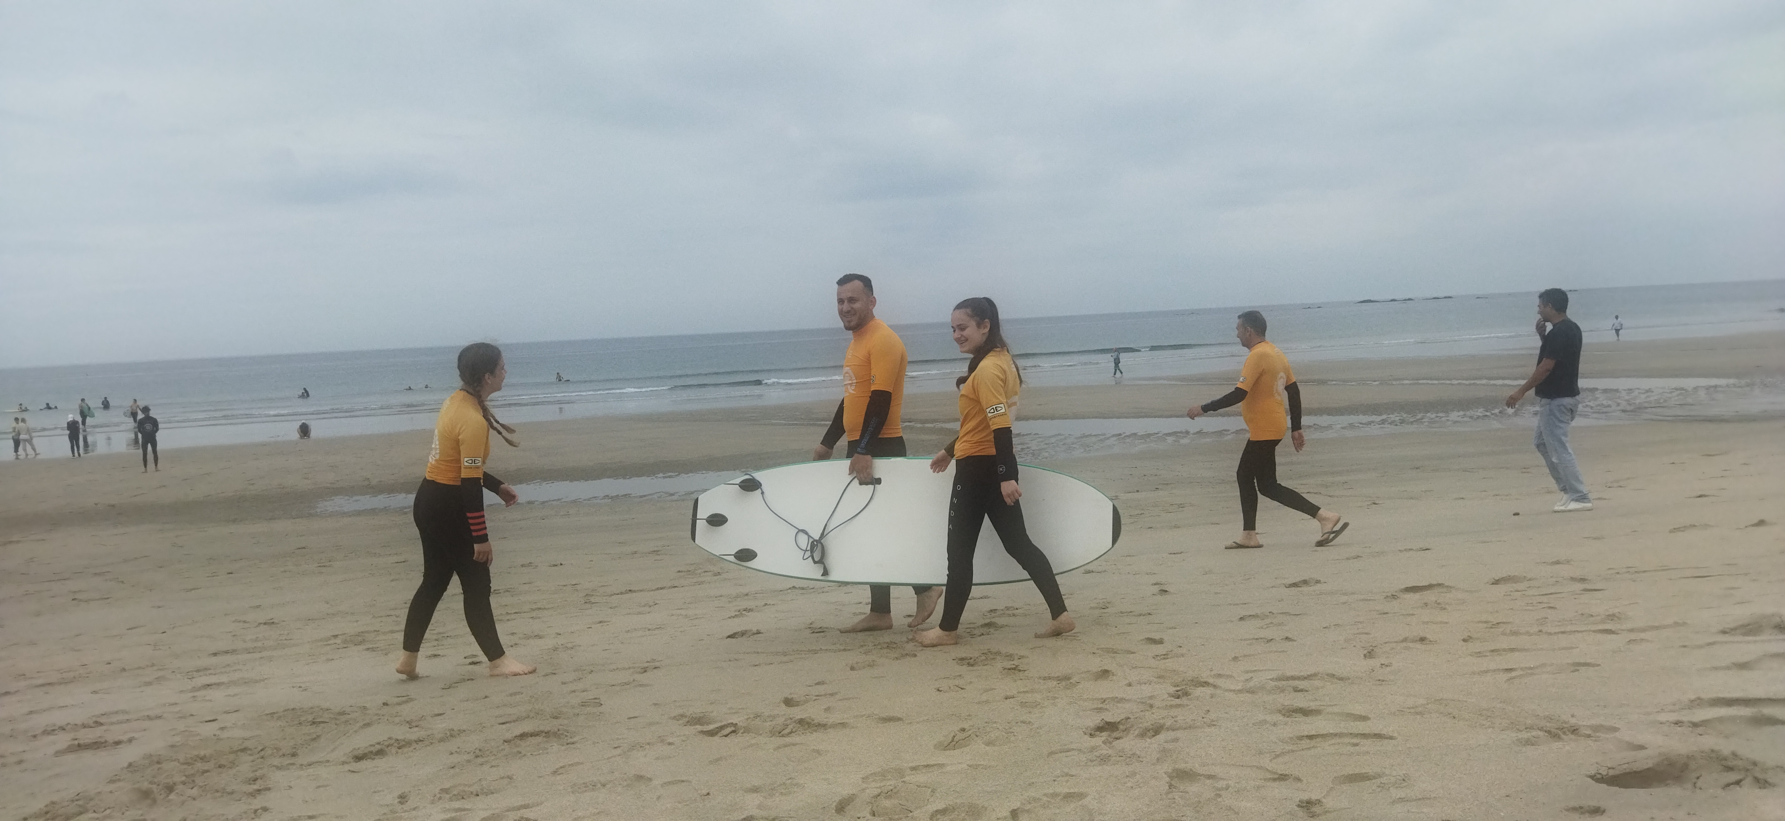
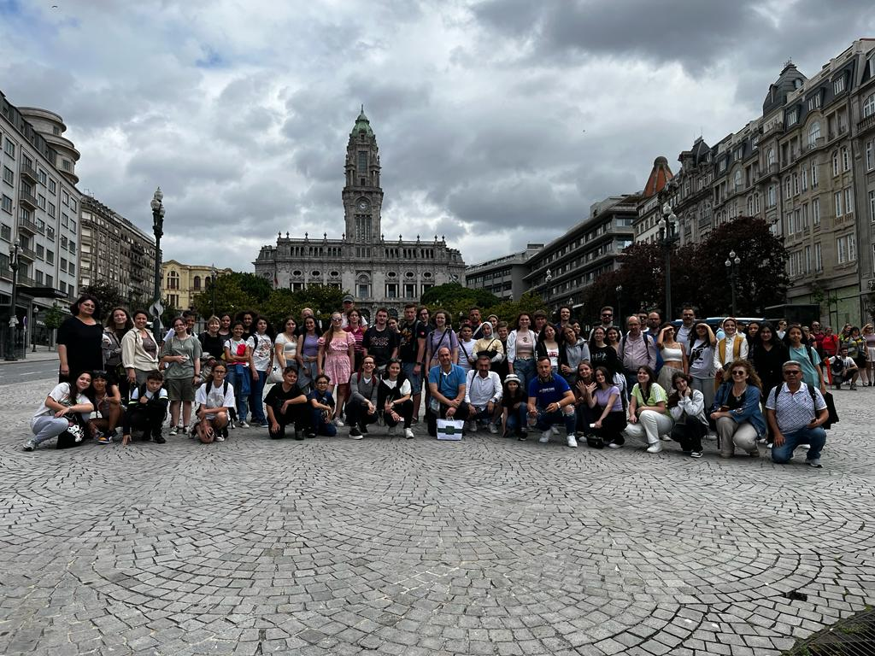
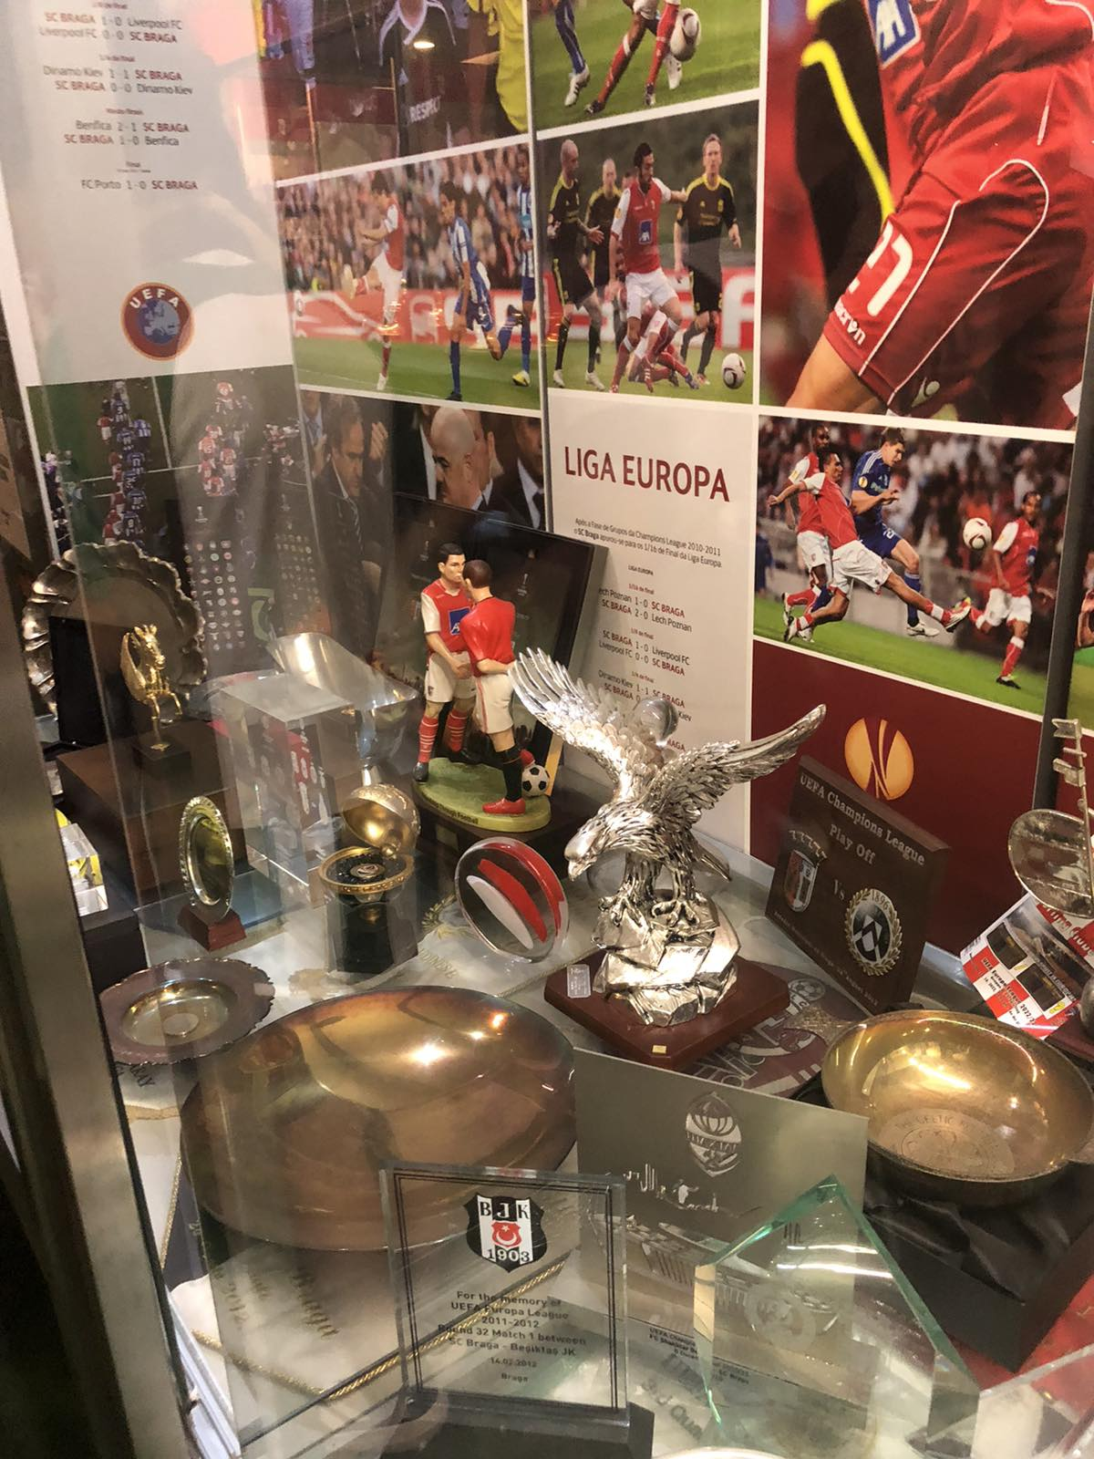
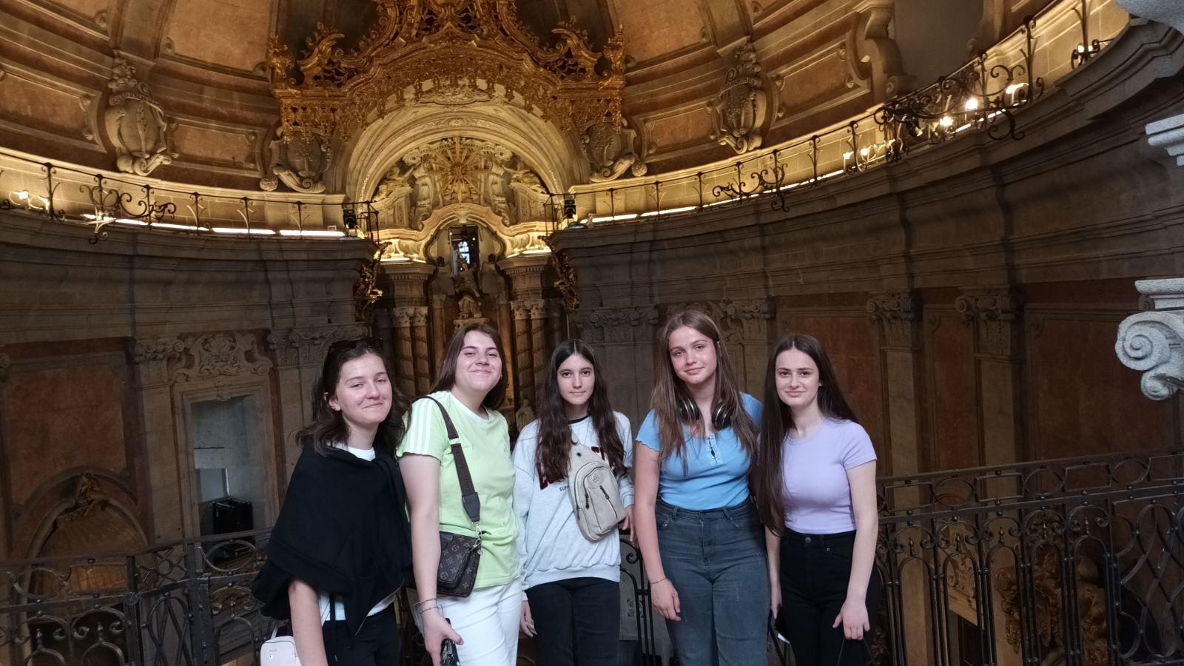
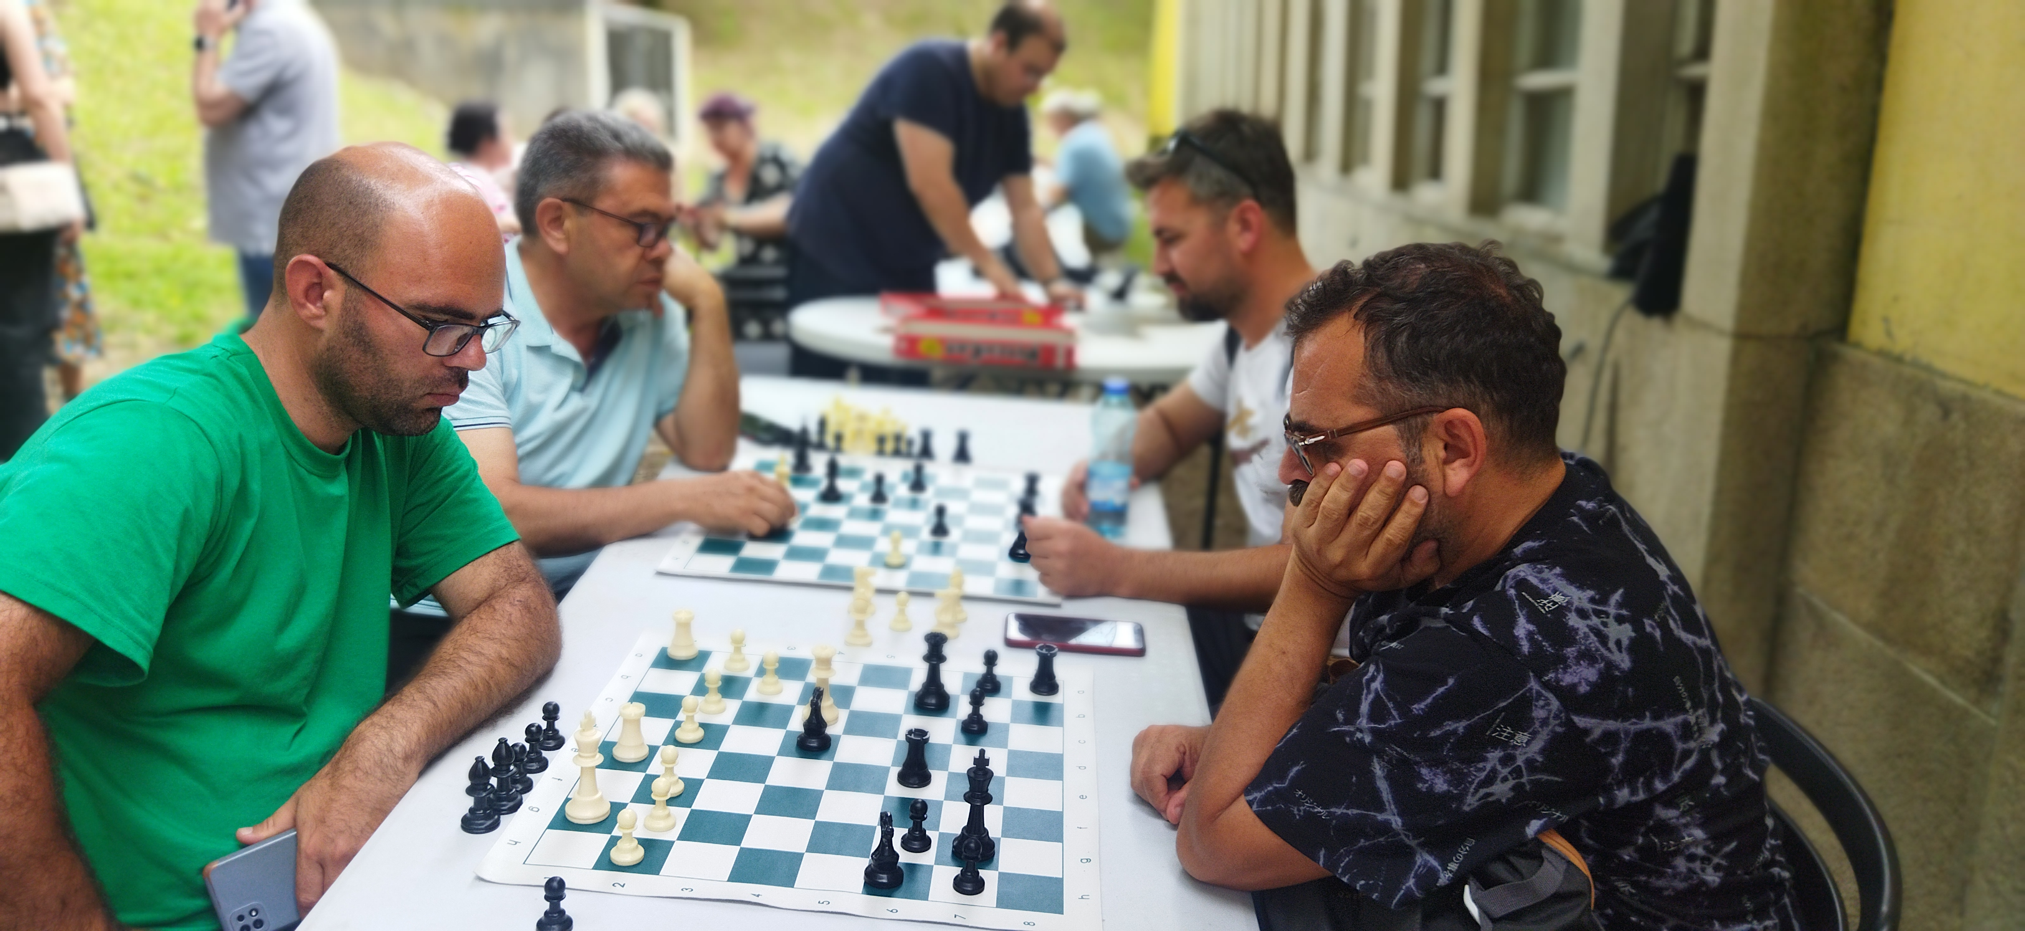
FOURTH MOBILITY SPORT– TADIM, PORTUGAL
5 – 10.03.2023
TEACHERS | STUDENTS
Ibraim Nedjipi Izeta Babachikj Kadir Nedjipi | Munisa Farizi Melisa Nuredin Erza Bekteshi Arbesa Idrizi Zejneb Shaipi

Slide 8
Thank you!

